Slide 1
Specify Timing Constraints in Little-JIL Processes
Wenzhe Wu

Slide 2
Outline
Introduction
Background
Proposed specification of timing constraints
Problems and Discussion
Further Work

Slide 3
Introduction
Motivation:
The timing of behavior is
an important aspect of process definitions
often critical for the correctness of overall processes
Goals:
Provide the capability for modeling timing constraints in Little-JIL processes
Provide runtime semantics and corresponding implementation approach

Slide 4
Outline
Introduction
Background
Little-JIL language
Timing constraints
Existing timing specification in Little-JIL
Proposed specification of timing constraints
Problems and Discussion
Further Work

Slide 5
Little-JIL Language
Little-JIL
is a graphic language for modeling processes
represents a unit of work as a step
each step has well defined events that indicate when a step enters one of its states:
posted
started
terminated
Completed
each event in Little-JIL represents a step entering one of its states

Slide 6
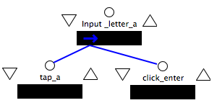
Timing Constraints
Timing Constraints:
on the timed sequence of events that a process is allowed to perform
are about the duration between the occurrences of any two events
Example:
For the above “input_letter_a” process, timing constraints could be:
1. “click_enter” must occur more than 0.1 seconds after “tap_a” occurs
2. “tap_a” must be finished in 0.1 seconds from when it’s started
Notes:
Specific to little-jil, put general backgound before discuss lttle-jil

Slide 7
Types of Timing Constraints
Delay: duration must be longer than a certain amount of time
delay from event A to B means that B must wait for some time to occur after A occurs
Deadline: duration must be shorter than a certain amount of time
deadline from event A to B means that B must occur shortly enough after A occurs
a part of deadline is already supported in Little-JIL
Notes:
Move to the proposed section

Slide 8
Existing Timing Specifications in Little-JIL
Deadline Timers
specify maximum durations on step executions
are defined only at leaf steps
if timer expires before step execution is done, Little-JIL system will throw an exception
Dynamic Scheduling proposed by A. Cass
tries to ensure that step will be completed within specified deadlines
allows for not scheduling some tasks while still scheduling the time-critical tasks(dynamic, not focus on what I am going to do)
takes all timing estimates, resource requirements, and current process state into account
Not expressive enough to represent needed timing requirements in processes
Notes:
The flow does not work
Evalute predicate after execution, define a timer at the beginning, throw ex when the step completes, check timer at the end of execution
The schedule jump over those steps
Computation resources

Slide 9
Outline
Introduction
Background
Proposed specification of timing constraints
Timers
Operations on Timers
Structures
Examples
Runtime Semantics
Problems and Discussion
Further Work

Slide 10
Timers
Timers
are variables that measure time progress
evaluate to real numbers
have increasing values at the same pace during the whole processes
Notes:
Local… can be global
Local for what if it can be seen from two steps
Constant Rate
Reason about it
Consider generalize the timers to be more general observers
Reason about it more than dynamic doing it

Slide 11
Operations on Timers
Users can manipulate timers with three ways:
Define a timer
initial value of every timer is zero
attached to step where timer starts at
Check a timer
evaluate predicate on current timer value
Update a timer
reset timer value to a non-negative real number
An operation can be defined with any step in the process
Notes:
User – process designer : create a define – set – kill
Timer accessible by

Slide 12
Operation Notation
define(Timer t, StepState s): this operation starts a timer object t, and t starts to count up when current step entering into its s state
s is one of {started, posted, completed, terminated}
check(Predicate p, StepState s): where p is a predicate on a timer value, this operation returns true if p is true when current step entering into its s state
update(Timer t, int i, StepState s): this operation resets timer object to to a new value I when current step entering into its s state
Notes:
Counting from know the time bounds
Which state it attached to
Delete operations
Read the remaining time
How to pass the timer.. As parameter??
Instantiate the object

Slide 13
Shortcomings
Delay constraints
violation only can be detected when timer is being checked
exception “TimerViolated” will be thrown in time
Deadline constraints
violation should be detected when time-out, which occurs before timer is being checked
exception “TimerViolated” will be thrown with a delay or, in worst case, never be throw
Notes:
Something suppose to happen but not happen ,throw sth to indicate sth bad happen
Want to do it to delay problem , its easier
Converse version
Guard! In execution, you can’t do it until… prevent it from doing it instead of throw exception

Slide 14
How to solve above problem
Overload the define operation!
define(Timer t, StepState s,[expected time period])
an alarm will be thrown when expected time period is reached
after giving alarm, timer still count up
an “TimerViolated” exception will be thrown at check operation of this timer
? How to keep the consistency between the define and check operations?
? How to pick the expected time period if this timer has several checks?

Slide 15
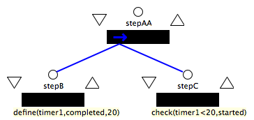
1st Example
A deadline timing constraint
stepC must be started in 20 time units from when stepB is completed
Define a Timer timer1 at stepB:completed
Check timer1 at stepC:started, if predicate is true, constraint holds, otherwise the constraints is violated

Slide 16
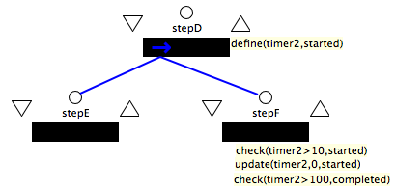
2nd Example
Two delay timing constraints using one timer
1st delay constraints: stepF can happen 10 time units after when stepD has completed
2nd delay constraints: from stepF starts to its completes, at least 100 units are needed
Note that several operations on same step will be executed by the order they were defined

Slide 17
Runtime Semantics
The runtime system
maintains a set of timers during the execution of Little-JIL processes
may throw three types of exceptions: (discussed later)
Timer is redefined
Timer predicate is violated
Timer is not existed
deletes the timer object after checking this timer once, unless there is an update operation right after the check operation
delete the useless timers to clean up the timer set

Slide 18
Exceptions – Redefine #1
There are 3 possibilities result in redefine problem, and there should be different reactions from the runtime system:
1. careless user defines a new timer with a duplicate name. In this case, a warning or error message should be given

Slide 19
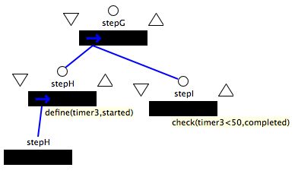
Exceptions – Redefine #2
2. Before the timer has been successfully checked, a reference of the step where definition was put on has been executed:
In this example, from first occurrence of stepH:started to stepI:completed, the time interval should be less than 50 time units
Since there is reference of stepH, timer3 will be redefined, an error message will be given, however a smarter way is to just use the first timer3 definition and to ignore other define operations

Slide 20
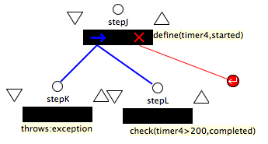
Exceptions – Redefine #3
3. Before the timer has been successfully checked, an exception handler require restarting the step with the timer definition:
Before timer4 has been checked by stepL, stepJ has to restart thus timer 4 has been redefined. In this case, whether user wants to use the original or the latest stepJ depends.
So, about redefine problem, runtime system will give warning. A smarter way to handle this problem will be treated as further work.

Slide 21
Outline
Introduction
Background
Proposed specification of timing constraints
Problems and Discussion
Further Work

Slide 22
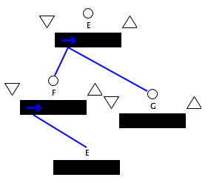
Recurrence Problem #1
Unroll the process:
E1
F1
G1
E2
F2
G2
For all i,
Fi has to start within 10 time units after Ei starts
E3
Timing constraint:
Step F has to start within 10 time units after parent step E starts
G3
F3
… …
Notes:
Every iteration, something’s may happen

Slide 23
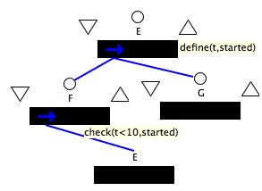
Recurrence Problem #2
Unroll the process:
E1
Define t
F1
G1
Check and delete t
Define t again
E2
F2
G2
Check&Delete
For all i,
Fi has to start within 10 time units after Ei starts
E3
Timing constraint:
Step F has to start within 10 time units after parent step E starts
G3
F3
… …
Notes:
Every iteration, something’s may happen

Slide 24
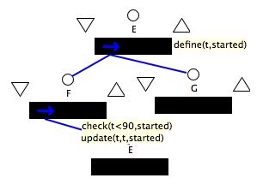
Recurrence Problem #3
Unroll the process:
E1
Define t
Check and update
F1
G1
E2
Redefine
F2
G2
For all i,
F_max has to start within 90 time units after E_1 starts
E3
Timing constraint:
The last executed Step F has to start within 90 time units after first step E starts
G3
F3
… …
Notes:
Every iteration, something’s may happen

Slide 25
Recurrence Problem #4
How to solve above problem:
1. ignore the redefine operation, as discussed previously, we can give define() a parameter to indicate – if this is a redefine, ignore this one
But for this example, after timer t is checked by the last executed F, t will be not deleted and left in memory!!
2. define timer with specified non-zero value, then pass the value of previous t to new defined t
But need programming

Slide 26
Outline
Introduction
Background
Proposed specification of timing constraints
Problems and Discussion
Further Work

Slide 27
Further Work
Conditional Timing Constraints
UI Design
Simple Implementation

